Slide 1
The CHAIN Worldwide Interoperability Demonstration Roberto Barbera, Univ. of Catania and INFN - Italy
CHAIN Workshop at EGI TF – Prague, 19 Sep 2012

Slide 2
Outline
The CHAIN vision
The CHAIN worldwide interoperability demonstration
Summary and conclusions

Slide 3
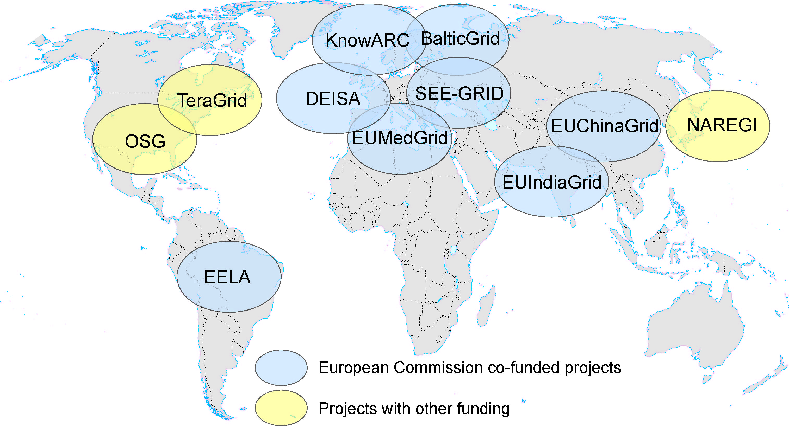
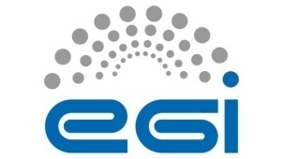
The Global Grid
CNGrid
EUAsiaGrid
NKN & Garuda
SAGrid & SANREN
GISELA

Slide 4
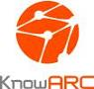





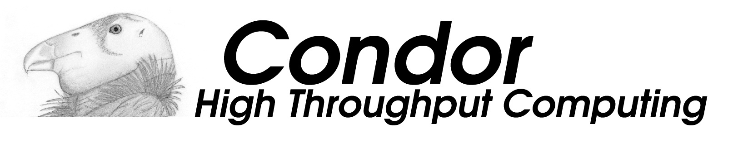


The “non-Global” middleware
CNGrid
Genesis II
EUAsiaGrid
NKN & Garuda
SAGrid & SANREN
GISELA

Slide 5
Project strategic vision
A world-wide Distributed Computing Infrastructure can address big scientific challenges that are not manageable with departmental computing systems
Virtual Research Communities can transparently access different kind of resources: scientific applications and tools, Data Repositories, down to CPUs and Disks. The vision is that of VRCs using resources ubiquitously across different administrative domains
Regional e-Infrastructures should be made interoperable among each other. CHAIN is committed to promote and validate a proof-of-concept that addresses this

Slide 6
Interoperability (http://en.wikipedia.org/wiki/Interoperability)
Interoperability is a property referring to the ability of diverse systems and organizations to work together (inter-operate). The term is often used in a technical systems engineering sense, or alternatively in a broad sense, taking into account social, political, and organizational factors that impact system to system performance;
According to ISO/IEC 2382-01 (Information Technology Vocabulary, Fundamental Terms), interoperability is "The capability to communicate, execute programs, or transfer data among various functional units in a manner that requires the user to have little or no knowledge of the unique characteristics of those units".

Slide 7
The CHAIN Worldwide Interoperability Demo (http://science-gateway.chain-project.eu)
To demonstrate that:
e-Infrastructures can be made interoperable to each other at user application level using standards
with the meaning of interoperability given in the previous slide;
VRC-specific applications can be submitted from anywhere and run everywhere

Slide 8
The CHAIN Worldwide Interoperability Demo - Requirements
The user interface must be only web based
Users must be transparently authenticated & authorised on all e-Infrastructures without any additional human/machine intervention
There must be the smallest possible interaction with both site managers and e-Infrastructure operators
No modification whatsoever of the various middleware should be required to their developers (missing JSAGA adaptors should be created)

Slide 9







The Catania Science Gateway model
Embedded Applications
Administrator
Power User
Basic User
.......
App. 1
App. 2
App. N
Science
Gateway
Standard-based (SAGA) middleware-independent
Grid Engine
Users from different organisations having different roles and privileges

Slide 10











AuthN & AuthZ Schema
Science Gateway
Authorisation
Authentication
1. Register to a Service
GrIDP
(“catch-all”)
IDPCT
(“catch-all”)
Social Networks’ Bridge IdP
IDP_y
2. Sign in
LDAP
.........

Slide 11
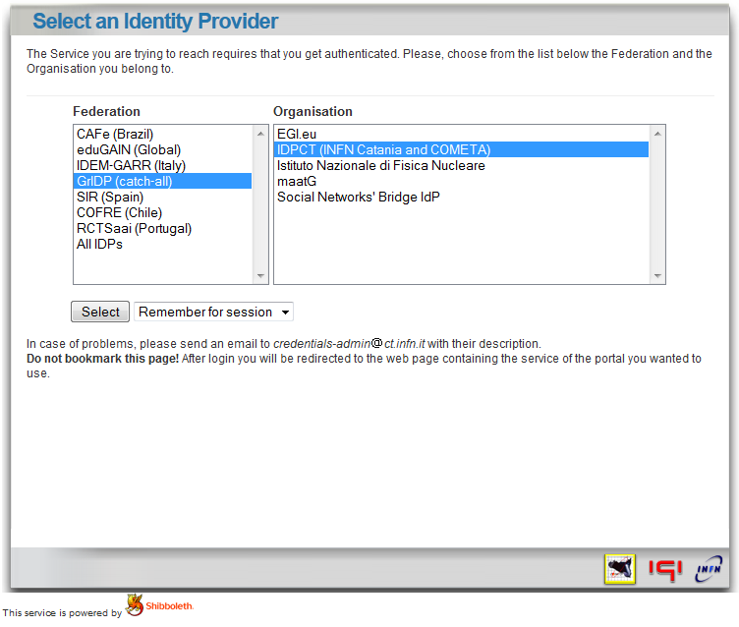
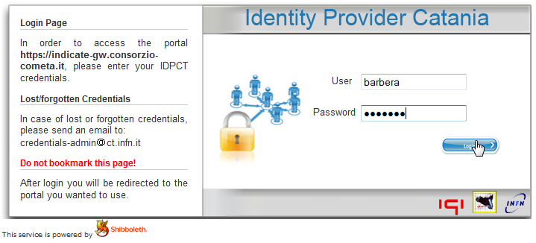
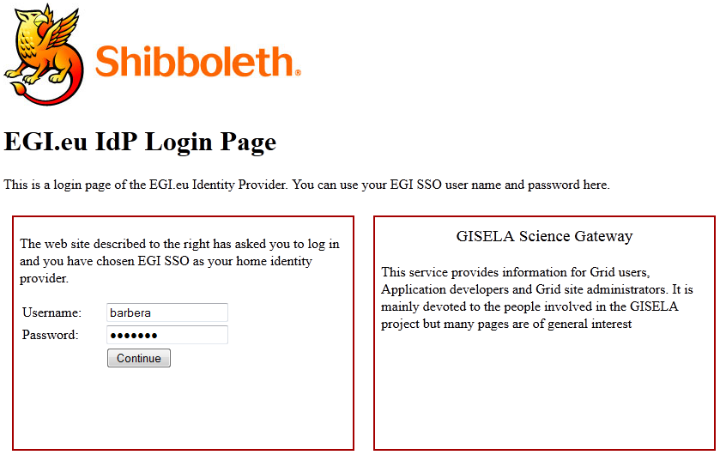
The normal Authentication Procedure
Identity Federations’ discovery service
«Open» Identity Provider
http://idp.ct.infn.it

Slide 12
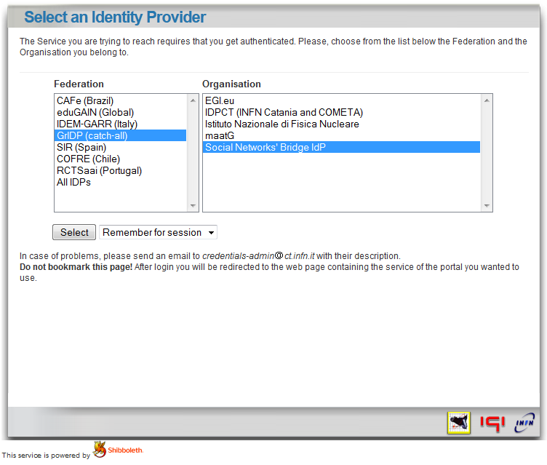
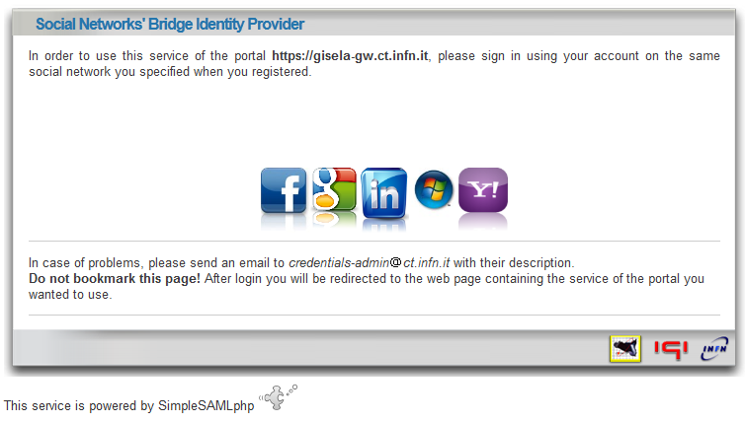
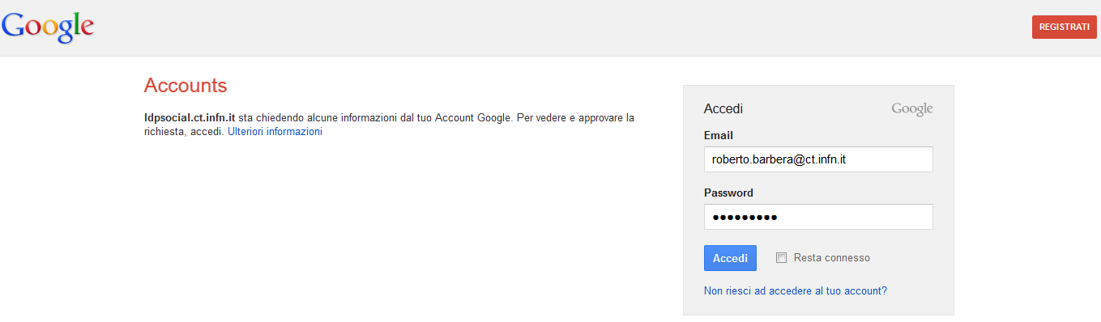
The “social” Authentication Procedure
Identity Federations’ discovery service
For more information watch
www.youtube.com/watch?v=w6wfuGUwVVU
https://idpsocial.ct.infn.it

Slide 13
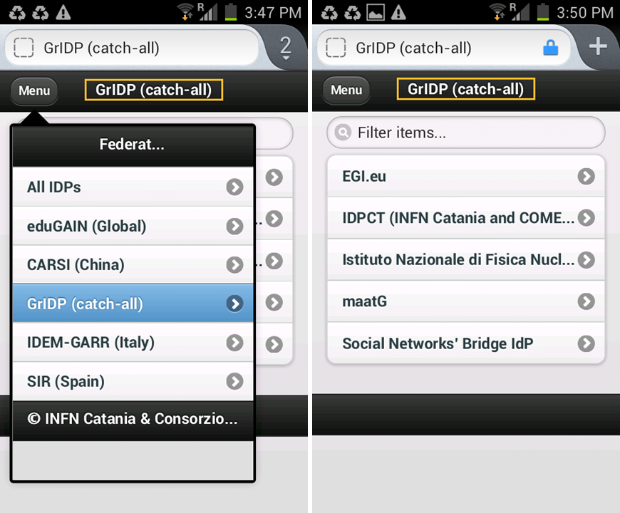

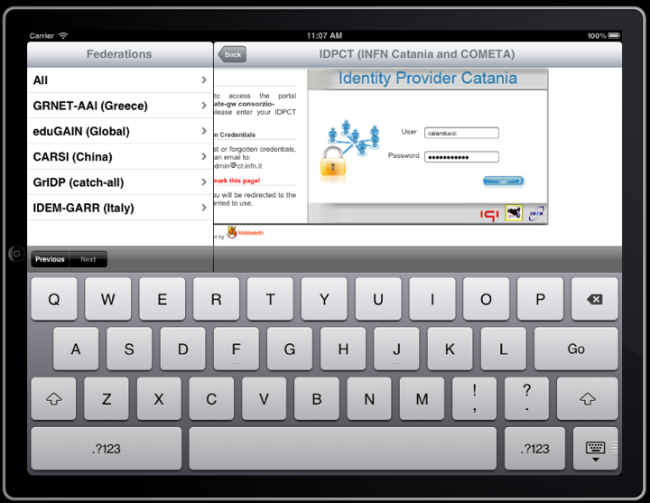
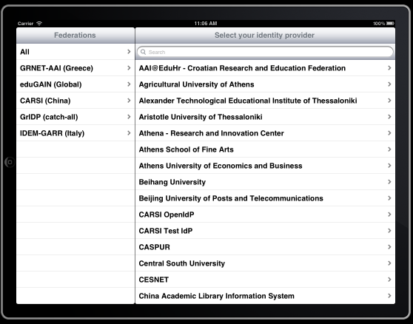
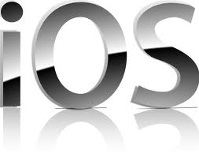
The “mobile” Authentication Procedure (REST API independent of the Science Gateway)

Slide 14
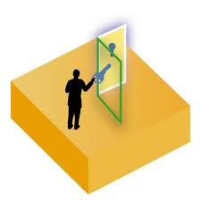

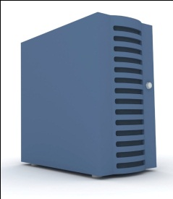

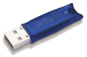
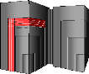

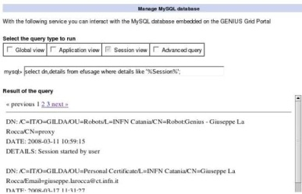

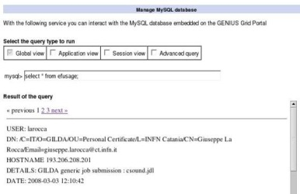
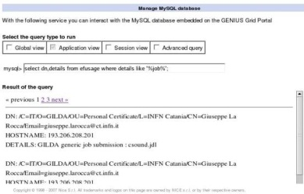
Catania Science Gateways access workflow
User Registry
eToken server
2’. authN
2”. authZ
3. create a proxy from an eToken server with robot certificates
Identity Provider
1. sign in
6. get the results
4. execute action
The Grid
User
5. get output
Admin
3’/4’. track user
Compliant with the EGI.eu Portal and Traceability Policies

Slide 15
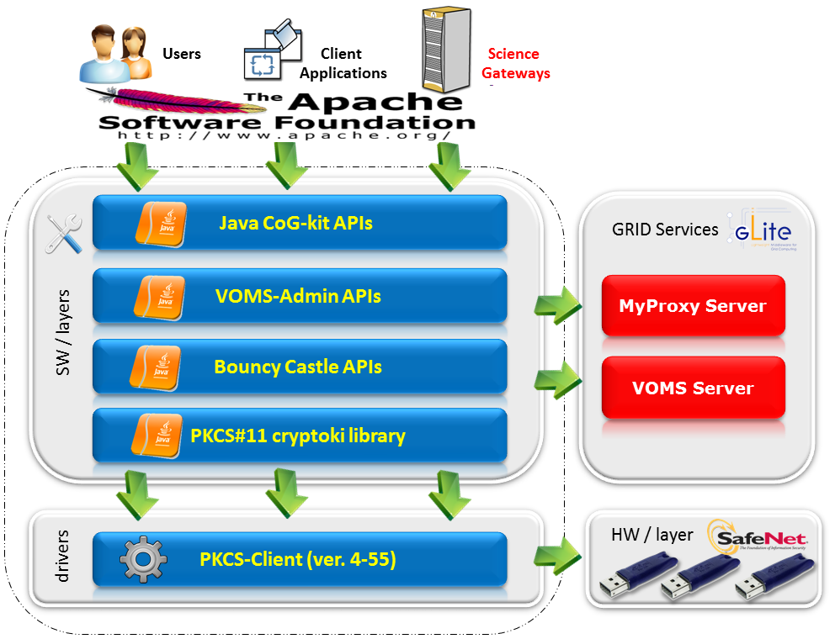
The «lightweight» crypto-library

Slide 16

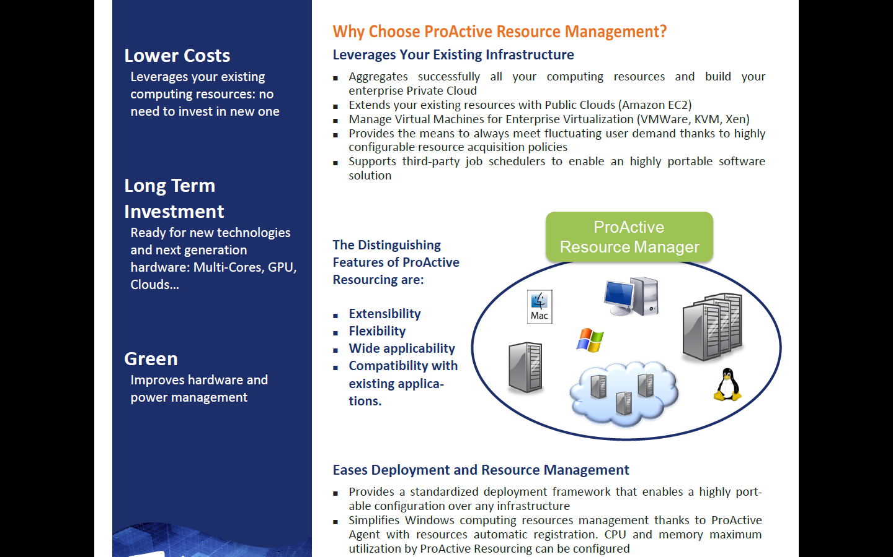
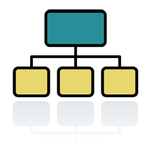



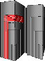
The eToken server working scenario
^{(*)} SSL encryption
ask for a service
list/create request
^{(*)}
eTokenServer
retrieve serials/proxy
get results
^{(*)}
execute a service
get the results back
store long proxy
ask/get VOMS AC attributes
VOMS Server
MyProxy Server

Slide 17
The Catania Grid Engine
Liferay Portlets
Science
GW 1
Science
GW 2
Science
GW 3
Grid Engine
eToken
Server
Science GW Interface
Data Engine
Job Engine
Users Track &
Monit.
Users
Tracking
DB
SAGA/JSAGA API
Grid MWs
Modified
New
New
Modified

Slide 18
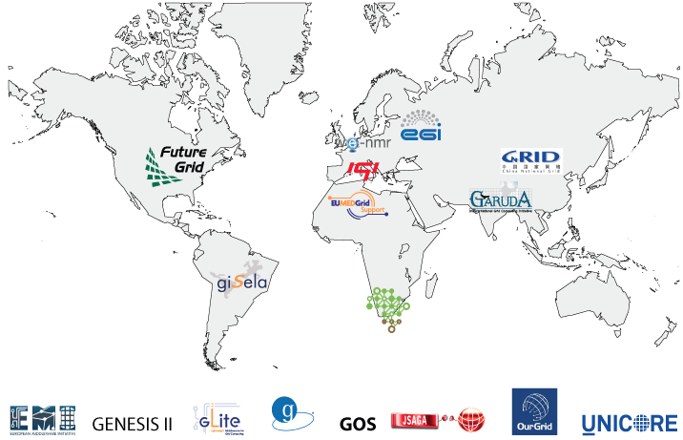



CHAIN Demo Contributors

Slide 19
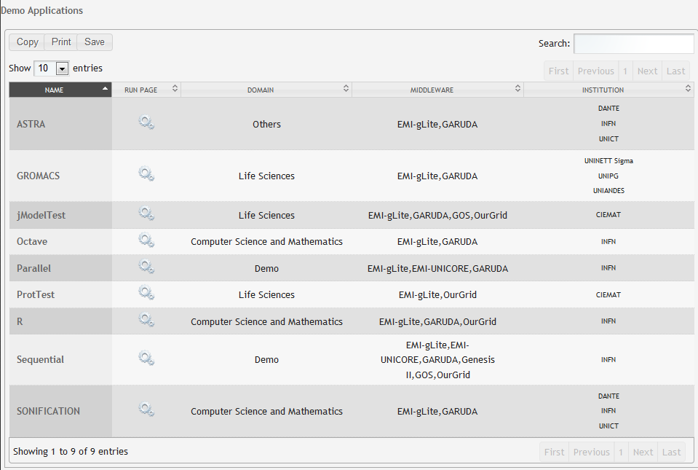
CHAIN Demo Applications (http://science-gateway.chain-project.eu/general-overview)
general purpose applications

Slide 20
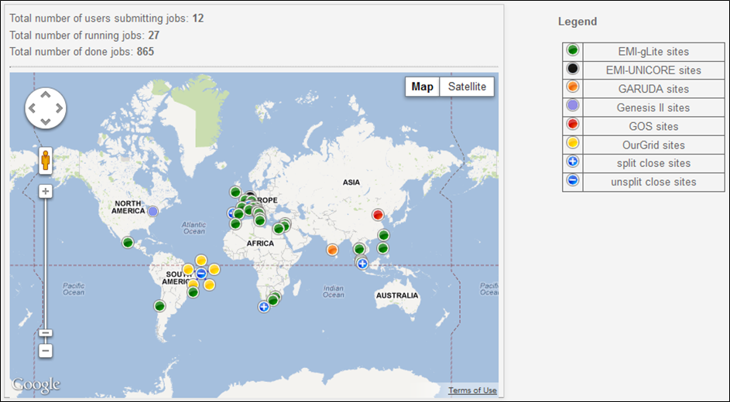
CHAIN Demo Status (http://science-gateway.chain-project.eu/demo-status)
See the demo in action at the CHAIN booth (no. 7 in the
exhibition area) and learn how to run it yourself !

Slide 21
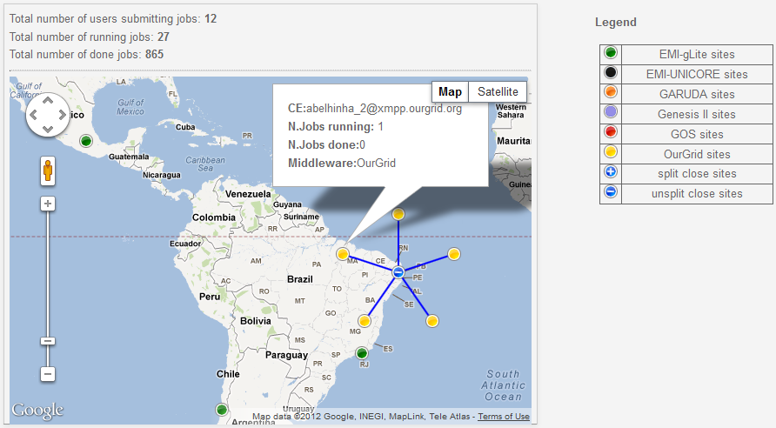
CHAIN Demo Status (http://science-gateway.chain-project.eu/demo-status)
Latin America

Slide 22
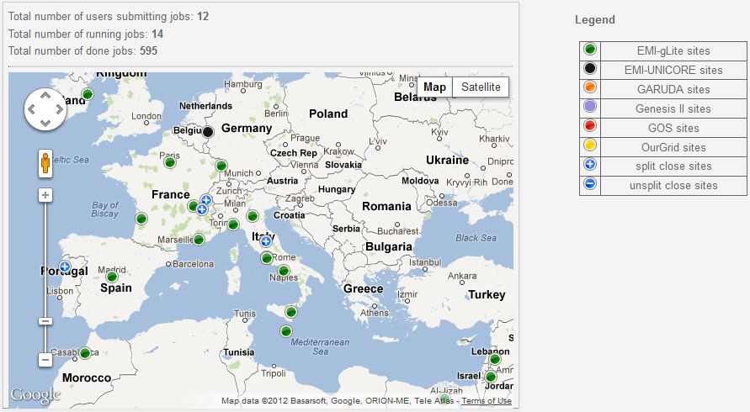
CHAIN Demo Status (http://science-gateway.chain-project.eu/demo-status)
Europe and the
Mediterranean

Slide 23
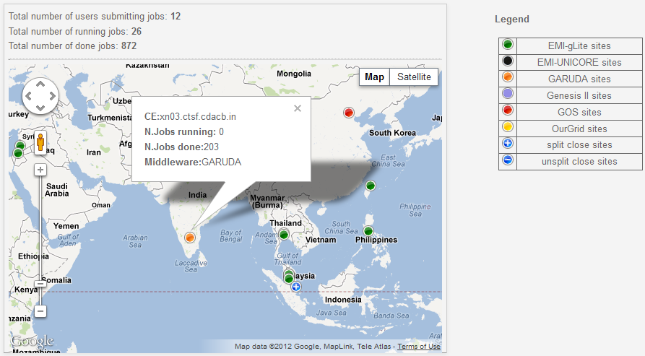
CHAIN Demo Status (http://science-gateway.chain-project.eu/demo-status)
Asia

Slide 24
Summary and conclusions
The CHAIN worldwide interoperability program demonstrates that users can access global e-Infrastructures in a seamless and ubiquitous way independently of the underlying middleware
The Catania Science Gateway framework with support for Identity Federations and Social Networks changes the way Grid infrastructures are used, hugely widening their potential user base across the continents, especially non-IT experts and the “citizen scientist”, yet keeping the required security
The adoption of standards (JSR 286, SAGA, SAML, etc.) represents a concrete investment towards sustainability
We need to discuss the future of the CHAIN Science Gateway after the demo

Slide 25
Thank you!

